Slide 1
Metrics Everywhere
Advanced Liferay monitoring
Miguel Ángel Pastor Olivar

Slide 2
About me?? Not sure if this is important

Slide 3

Notes:
What is the business value?
A new feature?
→An improved one?
Fewer bugs?
Don´t piss our users off with slow/ugly/pretty product
Easier evolution of the product?
Write unit test before fixing a complex bug?
Business Value is EVERYTHING which made people more likely to give use their money → So we want to generate more business value

Slide 4

Notes:
Make better decisions by using numbers.
Running code not writing code generates Business Value
So we need to know what our code does when it is running. We can´t do this if we don´t measure

Slide 5

Notes:
Why measure?
Madrid map is not exactly the same than the city of Madrid
Perception != Reality
Our mental model of our code is just this, a model, not the real code. And it is usually wrong.
Works, Possible Fail, Indeed fail
Which code is faster?
WE DON´T KNOW SO WE NEED TO MEASURE.
This affect on the way we make our decissions
Typical example: a bottleneck in a web page: rendering, database, and session storage. We need to find the Bottleneck
Improving our mental model by measuring what our code does. And we use our mental model to decide what to do so a better mental model makes better generating business value and better decisions
But only if we are measuring the right thing
And we need to measure our code where it matters

Slide 6
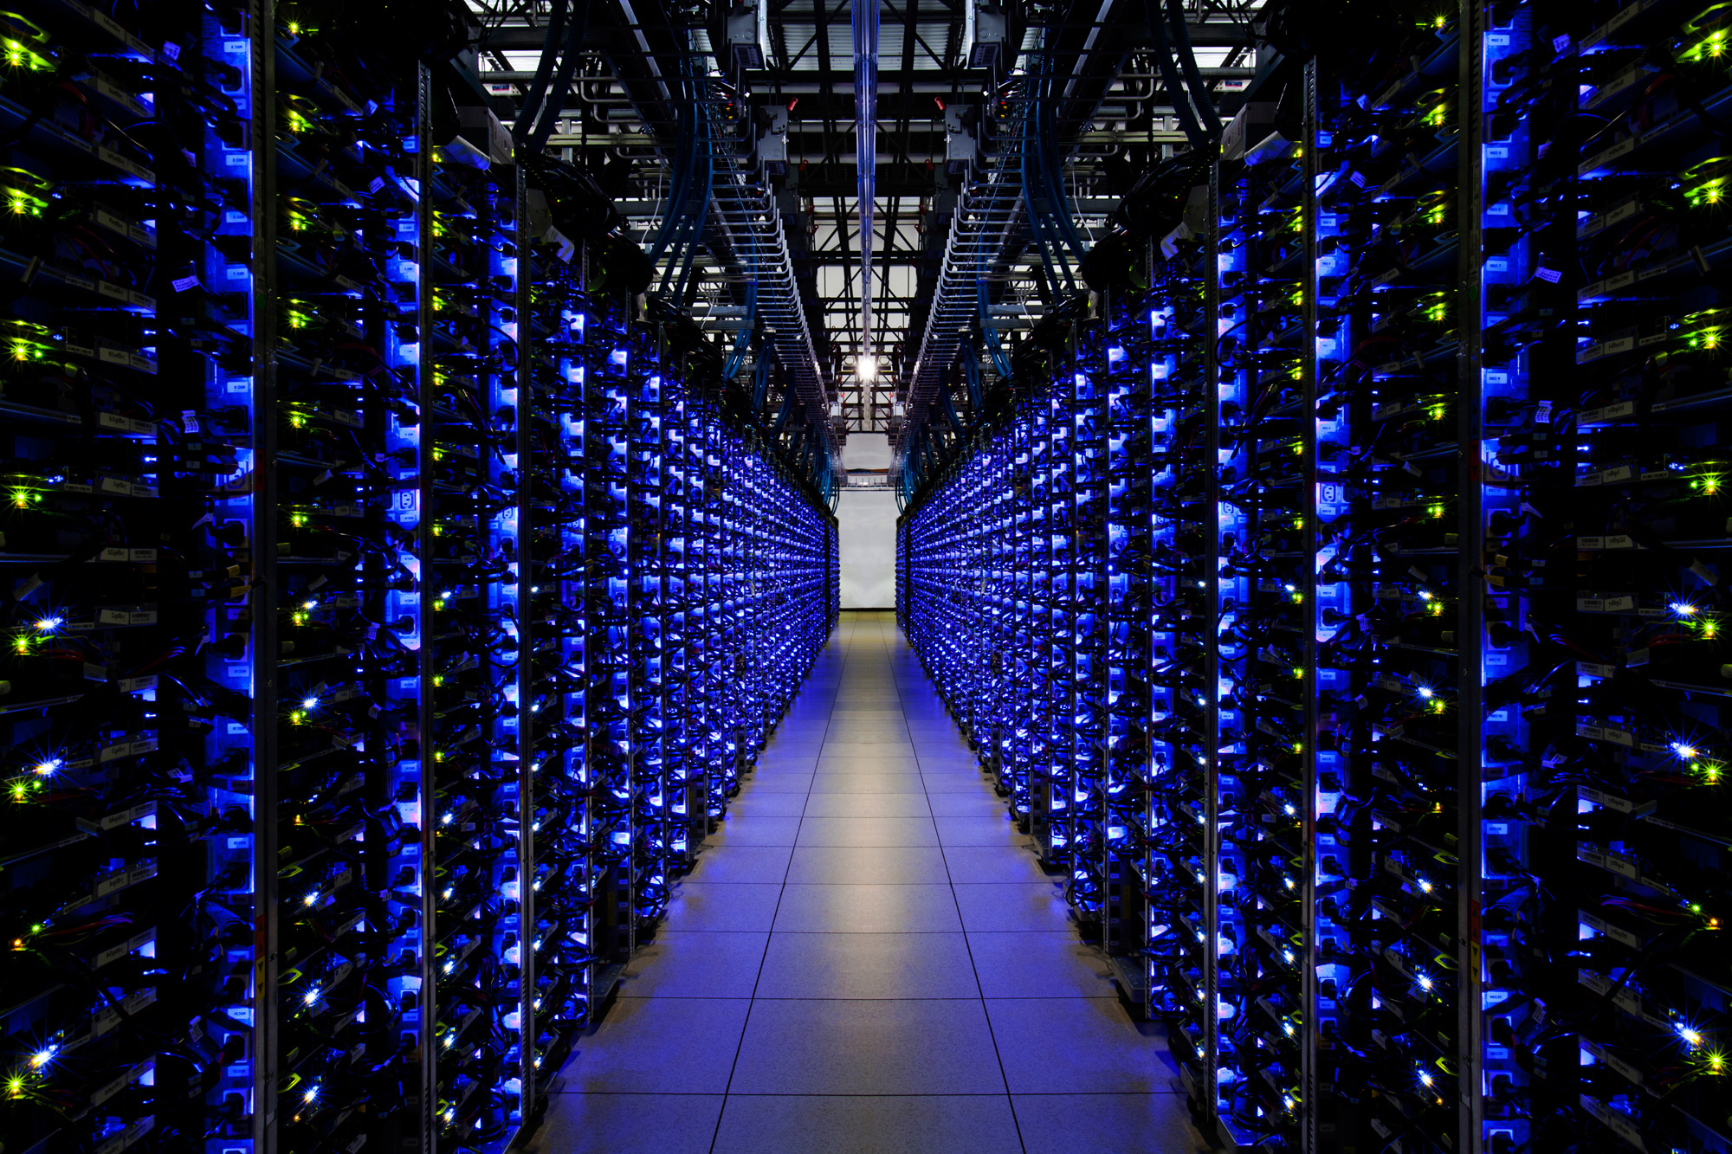
Notes:
Metrics in the Wild?
→We need to measure our code where it matters
→In the wild
Generating Business Value
IN PRODUCTION
Continuosly

Slide 7

Metrics
Notes:
Metrics Codahale
Powerful toolkit to measure the behaviour of critical components IN YOUR PRODUCTION ENVIRONMENT
Already builtin modules for Jetty, EhCache, Apache HttpClient
Reporting engines like Ganglia and Graphite
Every metrics is assoc to a class and has a name

Slide 8
PROPOSE AN EXAMPLE TO FOLLOW ALONG THE WHOLE DESCRIPTION OF THE METRICS

Slide 9

GAUGES
Instantaneous value of something

Slide 10

COUNTERS
An incrementing and decrementing value

Slide 11
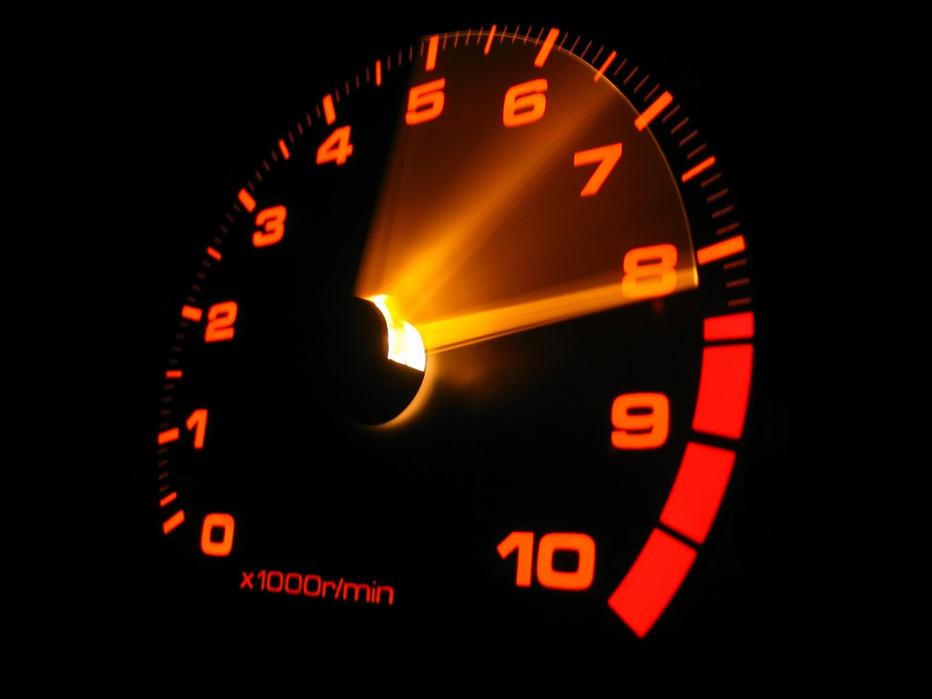
METRICS
Average rate of events over a period of time

Slide 12

HISTOGRAMS
Statistical distribution of values in a stream of data

Slide 13
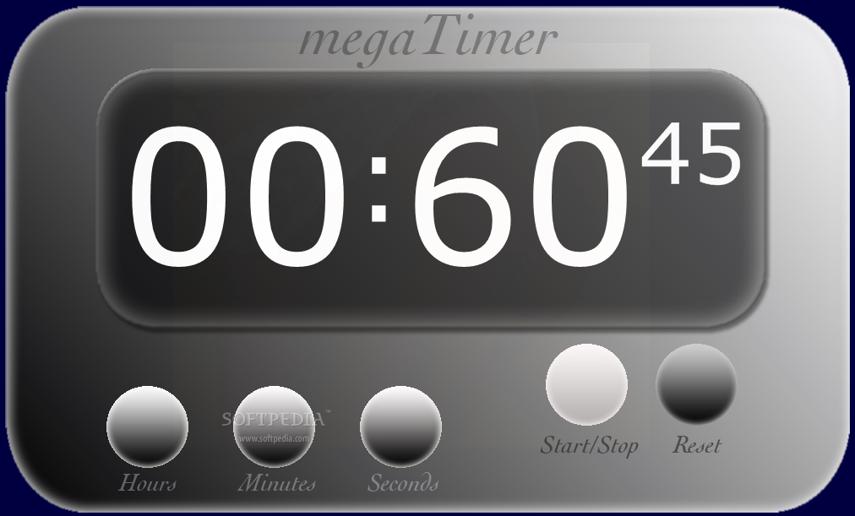
TIMER
Histogram of durations and a meter of calls

Slide 14
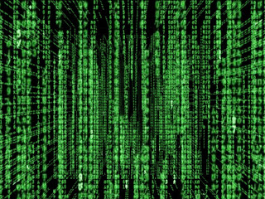
Notes:
And now?
Instrument → Could affect to yours Business Value? Add a metric
Collect → JSON via HTTP Every minute
Monitor → Nagios, … whatever. Affect to your BV? Somebody should be woken up ☺
Aggregate → Ganglia, Graphite, ..
OODA → Observe, Orient, Decide, Act

Slide 15
Highlight this is what we want to achieve with Liferay Cloud Services
Notes:
And now?
Instrument → Could affect to yours Business Value? Add a metric
Collect → JSON via HTTP Every minute
Monitor → Nagios, … whatever. Affect to your BV? Somebody should be woken up ☺
Aggregate → Ganglia, Graphite, ..
OODA → Observe, Orient, Decide, Act

